Slide 1
CSM 478 COMPUTER NETWORKS LECTURE 1: NETWORKING FUNDAMENTALS
FRIMPONG TWUM

Slide 2
NETWORK OVERVIEW
What is a Network?
Word-of-Mouth
Telephone
What is Computer Network?
c) An expansion of (a) and (b) above

Slide 3
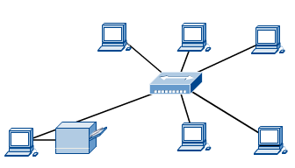
What is Computer Network?
A computer network is hence, a system of computers, print devices, network devices, and software, linked by communication media.
A computer network is simply two or more computers that are linked together.

Slide 4
What is Computer Network? Ctnue…(Some Definitions)
A computer network is simply two or more computers that are linked together.
A computer network is defined as having two or more devices (such as workstations, printers, or servers) that are linked together for the purpose of sharing information, resources, or both.
A computer network is hence a set of devices (often referred to as nodes) connected by communication links. A node can be a computer, printer, or any other device capable of sending and/or receiving data generated by other nodes on the network.

Slide 5

Types of connections: point-to-point and multipoint
1.<number>
Notes:
1.#

Slide 6
COMPUTER NETWORKS Vrs. DATA COMMUNICATIONS
Computer network exist so that data may be sent from one place to another: (this is the basic concept of Data Communications.
What is Data Communication?
The term telecommunication means communication at a distance. The word data refers to information presented in whatever form is agreed upon by the parties creating and using the data. Data communications are the exchange of data between two devices via some form of transmission medium such as a wire cable.
Computer Networks are the highways on which data travels.

Slide 7

Components of a Data Communications System
A Data Communications System has five components as follows:
The effectiveness of a data communications system depends on 4 fundamental characteristics: Delivery, Accuracy, Timelines, and Jitter

Slide 8

Data flow (Transmission modes)
Communication between two devices can be Simplex, Half-Duplex, and Full-Duplex

Slide 9
DISTRIBUTED PROCESSING
Computer Networks use distributed processing in which task is divided among multiple computers.
Instead of a single powerful computer handling all processing, each computer handles a subset process.
Advantages of distributed processing includes:
Security
Distributed Databases
Faster problem solving
Security through redundancy
Collaborative processing

Slide 10
BENEFITS OF A NETWORK
Information sharing: Authorized users can use other computers on the network to access and share information and data. This could include special group projects, databases, etc.
Hardware sharing: One device connected to a network, such as a printer or scanner, can be shared by many users.
Software sharing: Instead of purchasing and installing a software program on each computer, it can be installed on the server. All of the users can then access the program from a single location.
Collaborative environment: Users can work together on group projects by combining the power and capabilities of diverse equipment.

Slide 11
RISKS OF NETWORK COMPUTING
The security of a computer network is challenged everyday by:
  Equipment malfunctions
  System failures
    Note: equipment malfunctions and system failures may be caused by natural disasters such as floods, storms, or fires, and electrical disturbances
  Computer hackers
  Virus attacks
Ambrose, Bergerud, Busche, Morrison, and Wells-Pusins: IC3 BASICS, Thomson Course Technology, 2003

Slide 12
Criteria for assessing a computer network effectiveness and efficiency
To be considered effective and efficient, a computer network must meet three most important criteria as follows:
Performance (measured using Transit Time, Response Time). Depends on Number of users, Type of transmission medium, Hardware, Software
Reliability (measured by accuracy of delivery, network reliability, frequency of failure, recovery time of network after failure, network readiness in event of catastrophe.
Security (i.e. Protecting data from unauthorised access and viruses.

Slide 13
COMMUNICATIONS MEDIA
Communications Channel
  To transfer data from one computer to another requires some type of link through which the data can be transmitted. This link is known as the communications channel.
  To send data through the channel requires some type of transmission media, which may be either physical or wireless.

Slide 14
PHYSICAL MEDIA
Twisted-pair cable – consists of two independently insulated wires twisted around each other (least expensive type of cable—the kind that is used in many telephone systems)
Coaxial cable – consists of an insulated center wire grounded by a shield of braided wire (the primary type of cabling used by the cable television industry; it is more expensive than twisted pair)
Fiber-optic cable – contains hundreds of clear fiberglass or plastic fibers (threads) (made from thin, flexible glass tubing; bandwidth is greater, so it can carry more data; it is lighter than metal wires and is less susceptible to interference; it is fragile and expensive)
ISDN line – a special digital telephone line that transmits and receives information at very high speeds

Slide 15
WIRELESS MEDIA
Microwave system – transmits data via high-frequency radio signals through the atmosphere
Satellite system – receive transmitted signals, amplify them, and then transmit the signals to the appropriate locations
Cellular technology – uses antennae resembling telephone towers to pick up radio signals within a specific area (cell)
Infrared technology – transmits data as infrared light waves from one device to another, providing wireless links between PCs and peripherals
Note: The type of medium selected is determined by the type of network, the size of the network, and the cost.

Slide 16
TYPES OF NETWORK?
Computer Networks are typically classified according to their reach and complexity.
The most common types of networks are:
    Local Area Networks (LANS) and
    Wide Area Networks (WANS).
The primary difference between the two is that a LAN is generally confined to a limited geographical area, whereas a WAN covers a large geographical area. Most WANs are made up of several connected LANs.

Slide 17
TYPES OF NETWORKS
Local Area Network (LAN) – a network that spans a small area such as a building or an office.
  Software applications and other resources are stored on a file server.
  Print servers enable multiple users to share the same printer.
Wide Area Network (WAN) – a network that spans a wide geographical area; there are several types of WANS
  Metropolitan area network (MAN)
  Public access network (PAN)
  Value added network (VAN)
  Virtual private network (VPN)
ENTERPRISE NETWORK!!!

Slide 18

An isolated LAN connecting 12 computers to a hub in a closet
1.<number>
Notes:
1.#

Slide 19

WANs: a switched WAN and a point-to-point WAN
1.<number>
Notes:
1.#

Slide 20

A heterogeneous network made of four WANs and two LANs
1.<number>
Notes:
1.#

Slide 21
TYPES OF NETWORKS
Intranet – An intranet is a private LAN designed for use by everyone within an organization. An intranet might consist of an internal e-mail system, a message board and one or more Web site portals that contain company news, forms, and personnel information.
Access to an intranet’s web site is restricted by a firewall.
Extranet – a network that connects people within your company with people who are outside your company--all within a secure, password-protected network that can be accessed from anywhere.
people who are outside your company--all within a secure, password-protected network that can be accessed from anywhere.

Slide 22
HOW ARE NETWORKS CATEGORIZED?
Networks are usually classified using three properties:
    Protocol
    Architecture
    Topology

Slide 23
CATEGORISATION BY NETWORK/COMMUNICATION PROTOCOLS
A protocol is simply an agreed-on set of rules and procedures for transmitting data between two or more devices.
Features determined by the protocol are:
  How the sending device indicates it has finished sending the message.
  How the receiving device indicates it has received the message.
  The type of error checking to be used.

Slide 24
NETWORK/COMMUNICATIONS PROTOCOLS
NETWORK PROTOCOLS: Most networks use Ethernet, but some network may use IBM’s Token Ring protocol.
COMMUNICATIONS PROTOCOLS: On the Internet, the major protocol is TCP/IP (an acronym for Transmission Control Protocol/Internet Protocol).

Slide 25
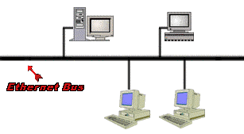
EXAMPLE OF AN ETHERNET BUS
Ethernet LANs use a bus topology.
All stations are connected to a single long cable.
Any station can send a signal along the cable, which all other stations will receive. Unlike ring topologies, the cable doesn't close a loop.

Slide 26
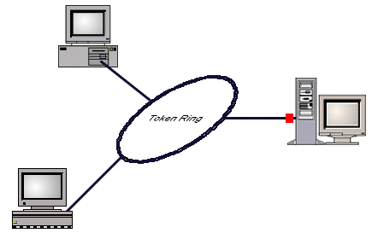
TOKEN RING NETWORK
A token passing ring LAN is a group of computers connected in a loop. The group uses a token passing access mechanism.
A computer wishing to send data should first receive permission. When it gets control of the network it may transmit a frame. Each frame transmitted on the ring is transmitted from one computer to the next, until it ultimately returns to the initiator of the transmission.

Slide 27
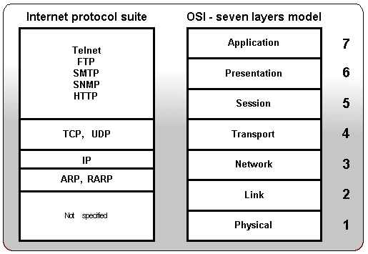
INTERNET PROTOCOLS

Slide 28
CATEGORISATION BY NETWORK ARCHITECTURE
Network architecture – refers to the way a network is designed and built. The two major types are:
  Peer-to-peer architecture – Computers connect with each other in a workgroup to share files, printers, and Internet access. This is used to connect a small number of computers.
  Client/server architecture – sends information from a client computer to a server, which then relays the information back to the client computer, or to other computers on the network
Networks for Beginners: http://compnetworking.about.com/

Slide 29

CATEGORISATION BY NETWORK TOPOLOGY
1.<number>
Notes:
1.#

Slide 30
NETWORK
TOPOLOGIES
Network Topology (or layout) – refers to the way computers and peripherals are configured to form networks
  Bus topology – all computers are linked by a single line of cable
  Star topology – multiple computers and peripheral devices are linked to a central computer, called a host
  Ring topology – each computer or workstation is connected to two other computers, with the entire network forming a circle
  Hybrid topology – combine network layout
  types to meet their needs

Slide 31

A bus topology connecting three stations
1.<number>
Notes:
1.#

Slide 32

A star topology connecting four stations
1.<number>
Notes:
1.#

Slide 33

A ring topology connecting six stations
1.<number>
Notes:
1.#

Slide 34

A fully connected mesh topology (five devices)
1.<number>
Notes:
1.#

Slide 35

A hybrid topology: a star backbone with three bus networks
1.<number>
Notes:
1.#

